Slide 1



Module 4. Lesson 2.
The Easy
Editor app. Part 1
Link to the methodological guidelines

Slide 2

Module 4. Lesson 2. The Easy Editor app P. 1
Discussion:
Project planning

Slide 3
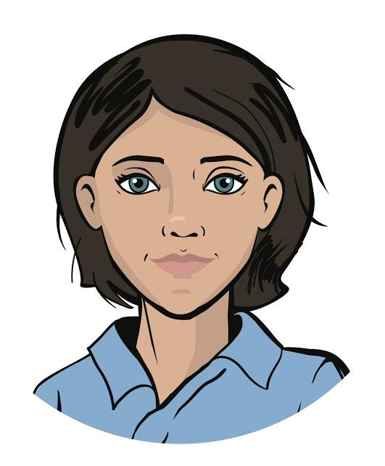

Starting a big order!
Last time, a representative of the Ministry for Social Development turned to ProTeam specialists.
He is making a software package for the elderly people.
One of the apps should be an Easy Editor photo editor.
To deliver the app on time, we need to plan our work on the order!
Discussion of tasks
Emily,
Project Manager

Slide 4
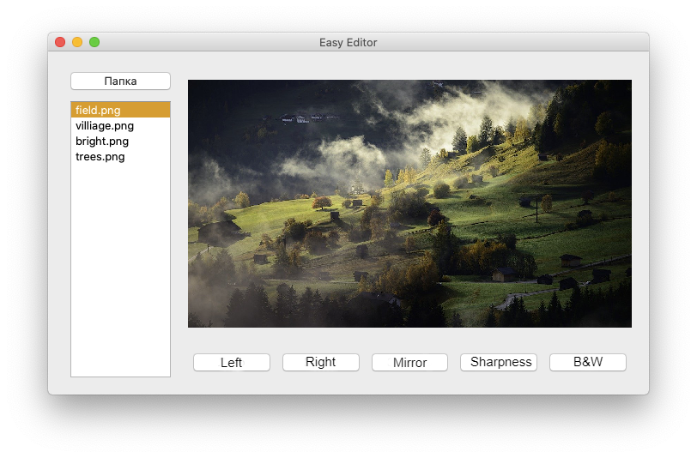
Technical specification
The goal is to program the Easy Editor app.
Expected app view:
Folder
Discussion of tasks
Notes:
Folder
Image
Left
Right
Mirror
Sharpness
b/w

Slide 5
Technical specification
The goal is to program the Easy Editor app.
Requirements:
The interface must be like in the picture.
Ability to select a folder with images on a computer.
Processing tools:
“Make it black and white”.
“Rotate left (90°)”.
“Rotate right (90°)”.
“Sharpen”.
“Mirror (left to right)”.
Saving edited photos (copies of the original) to a new Modified subfolder.
Discussion of tasks

Slide 6
Planning work on the project
Let’s build the project mind map :
Maintaining a list of images
Interface development
Photo editor
Discussion of tasks
Image processing
Developer Cole has already identified three main areas.
What blocks can be added to the flowchart?

Slide 7
Planning work on the project
Project mind map:
Loading a list of images from a folder
Selecting an image for editing
Selected image preview
Creating widgets
Placing in layouts
Maintaining a list of images
Interface development
Photo editor
Discussion of tasks
Image processing
Turn right
Turn left
Mirror reflection
B/w
Sharpen
Save result

Slide 8
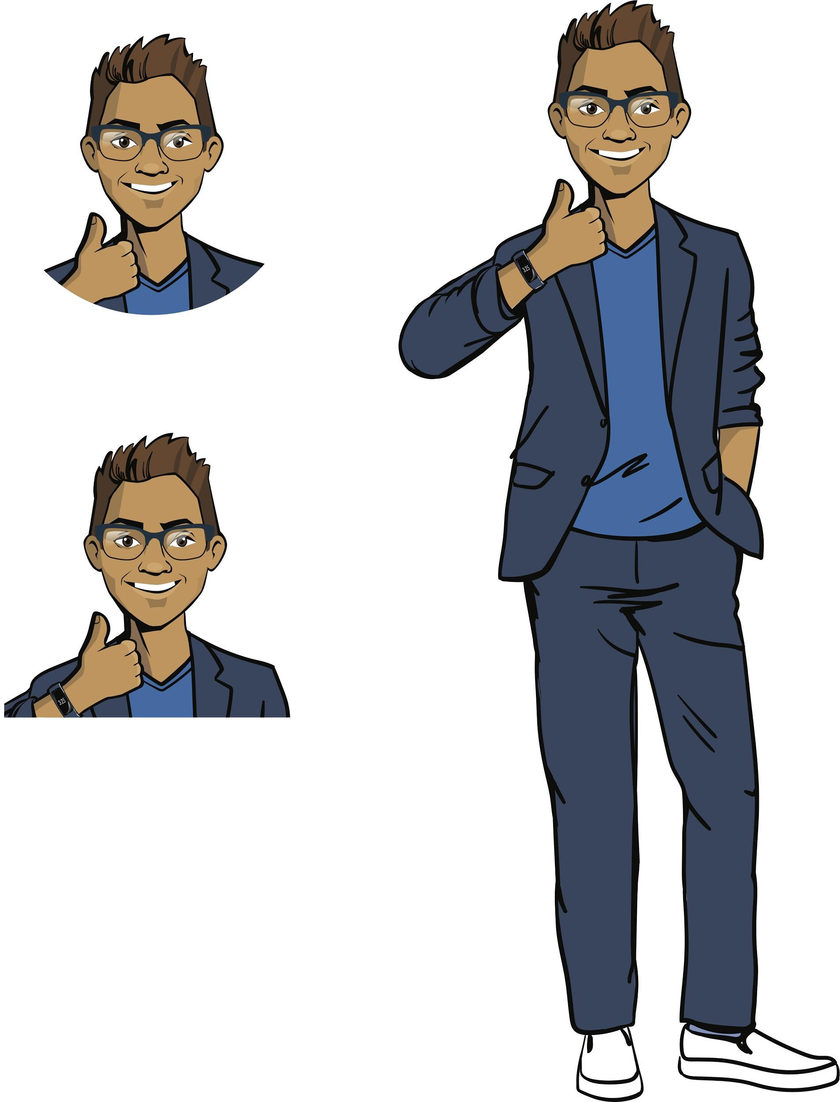
Planning work on the project
Checklist based on the mind map:
Create an interface for the app.
Ensure loading images from the required folder.
Show a preview of the image selected in the list.
Program editing of a photo:
creating a modified copy;
showing a preview of the modified copy;
saving to the Modified subfolder.
Discussion of tasks

Slide 9
Planning work on the project
Checklist based on the mind map:
Create an interface for the app.
Ensure loading images from the required folder.
Show a preview of the image selected in the list.
Program editing of a photo:
creating a modified copy;
showing a preview of the modified copy;
saving to the Modified subfolder.
Today
Discussion of tasks

Slide 10
Planning work on the project
Project mind map:
Loading a list
of images from a folder
Selecting an image for editing
Selected image preview
Creating widgets
Placing in layouts
Maintaining a list of images
Interface development
Photo editor
Discussion of tasks
Tasks for today
Image processing
Turn right
Turn left
Mirror reflection
B/w
Sharpen
Save result

Slide 11
The goal of the working day is
to create an interface for the Easy Editor app and configure uploading images from any folder on a computer.
Today you will:
Discussion of tasks
Recall how to build interfaces using PyQt.
Start exploring the capabilities of the os module for working with an operating system.
Program your own DirList class to load and display a list of images.

Slide 12

Module 4. Lesson 2. The Easy Editor app P. 1
Qualification

Slide 13
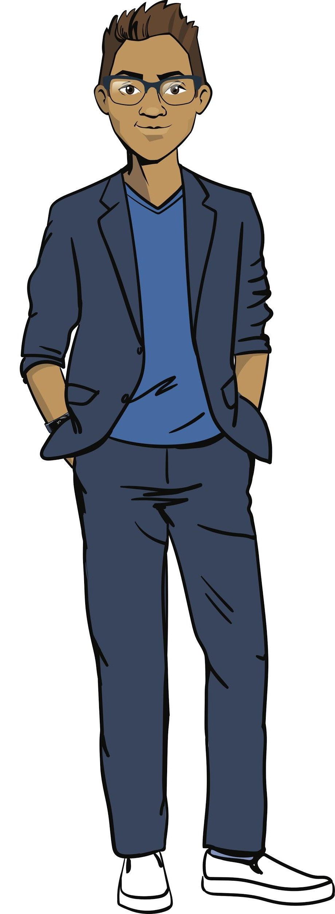
Demonstrate your knowledge
of scopes and UI elements
Qualification

Slide 14
What formats of graphic files do you know?
How does the file format differ from the extension?
Qualification

Slide 15
Graphic file formats:
JPG.
PNG.
BMP.
SVG.
EPS.
etc.
Qualification
filename
abc
Name
Extension
FILENAME

Slide 16
Show and name all the widgets in the picture:
Folder
Qualification

Slide 17
Widget names:
Static label/image — QLabel
App window — QWidget
Folder
Selectable list — QListWidget
Qualification
Button — QPushButton

Slide 18
How to create an empty application window?
List the PyQt5 modules and commands required.
Qualification
If you are confused, use the theoretical documentation!

Slide 19
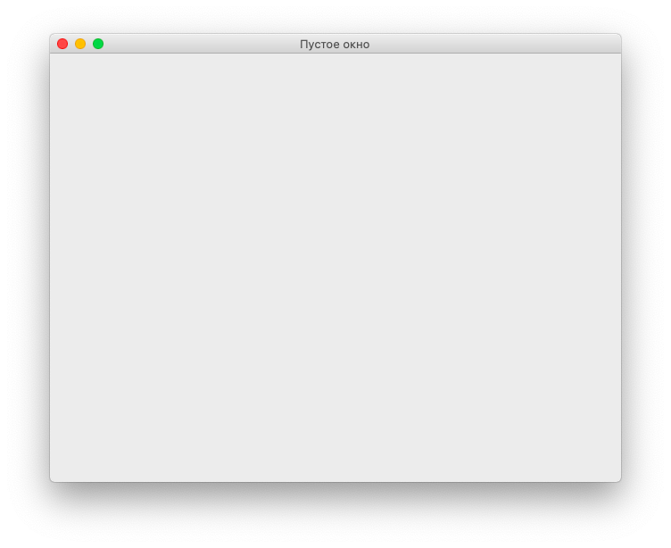
Creating an empty application window:
from PyQt5.QtWidgets import QApplication, QWidget
app = QApplication([])
main_win = QWidget()
main_win.setWindowTitle('Empty window')
main_win.show()
app.exec_()
Empty window
Qualification

Slide 20
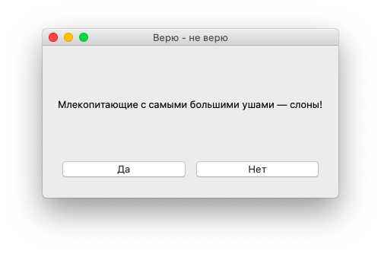
How do I create and position widgets in an empty window like in the picture?
Believe it or not
Mammals with the largest ears are elephants!
Qualification
Yes
No
If you are confused, use the theoretical documentation!
Notes:
Believe it or not
Mammals with the largest ears are elephants!
Yes
no

Slide 21
from PyQt5.QtWidgets import QApplication, QWidget, QPushButton, QLabel, QVBoxLayout, QHBoxLayout
from PyQt5.QtCore import Qt
app = QApplication([])
main_win = QWidget()
main_win.resize(300, 200)
main_win.setWindowTitle('Believe it or not')
statement = QLabel('Mammals with the largest ears are elephants!')
btn_yes = QPushButton('Yes')
btn_no = QPushButton('No')
line1 = QHBoxLayout()
line2 = QHBoxLayout()
line1.addWidget(statement, alignment = Qt.AlignCenter)
line2.addWidget(btn_yes)
line2.addWidget(btn_no)
line3 = QVBoxLayout()
line3.addLayout(line1)
line3.addLayout(line2)
main_win.setLayout(line3)
main_win.show()
app.exec_()
Qualification
Believe it or not
Mammals with the largest ears are elephants!
Yes
No
Notes:
Believe it or not
Mammals with the largest ears are elephants!
Yes
no

Slide 22
What is a global variable?
How to create it?
Qualification

Slide 23
Global variable
is a variable that is visible (accessible) from any part of the program.
Local variable
is a variable that is declared and used only inside functions.
def setName(name, format):
filename = name + '.' + format
return filename
filename = setName(name, format)
print(filename)
Global variable
is declared in the main part of the program. Its value can be obtained and changed in any part of the program.
filename = ''
def setName(name, format):
global filename
filename = name + '.' + format
setName('pic', 'jpg')
print(filename)
Qualification

Slide 24
Qualifications confirmed!
Great, you are ready to brainstorming and complete your work task!
Qualification

Slide 25

Module 4. Lesson 2. The Easy Editor app P. 1
Brainstorm:
Easy Editor interface

Slide 26
Let’s take a close look at the interface
Folder
Brainstorming
We will program the list of images later.
Instead of a graphic file from the list, let's make the inscription “Image” for now.

Slide 27
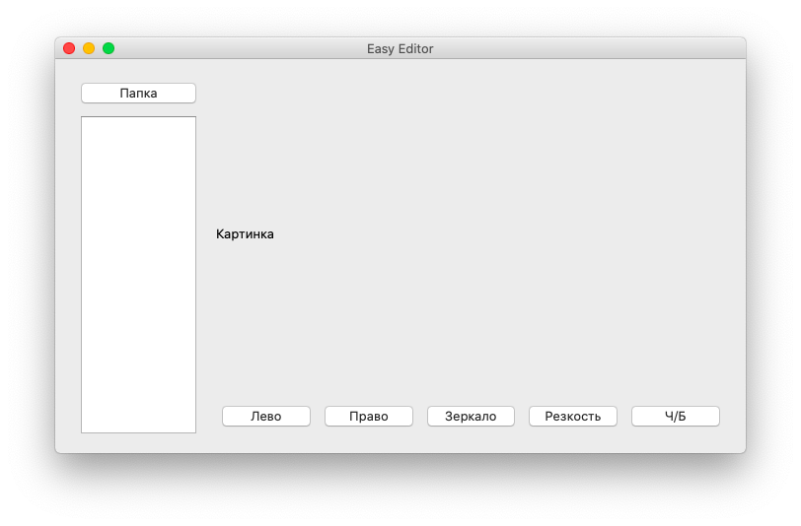
Let’s take a close look at the interface
Folder
Image
Brainstorming
How can we program such an interface?
How to place widgets in layouts?

Slide 28
Placing widgets
Folder
Image
4
Brainstorming
2
1
3

Slide 29
Creating an interface
from PyQt5.QtWidgets import
Required PyQt modules
app = QApplication([])
win = QWidget()
btn_dir = QPushButton("Folder")
Creating widgets
And other interface elements
win.resize(700, 400)
And other properties of elements
row = QHBoxLayout()
Brainstorming
And other layouts
Placing in layouts
col1.addWidget(btn_dir)
Placing widgets in layouts
win.setLayout(row)
win.show()
app.exec()
Placing in layouts

Slide 30
Your task:
Program the Easy Editor app interface.
The required parameters can be found in the technical specification
Use the technical documentation from previous workdays, if needed.
Brainstorming
Cole,
Senior Developer

Slide 31

Module 4. Lesson 2. The Easy Editor app P. 1
VS Code:
The Easy Editor app

Slide 32




Complete task 1 in VS Code
The Easy Editor app
Visual Studio Code
Working on the platform

Slide 33
Module 4. Lesson 2. The Easy Editor app P. 1
Brainstorming:
Loading a list of graphic files

Slide 34
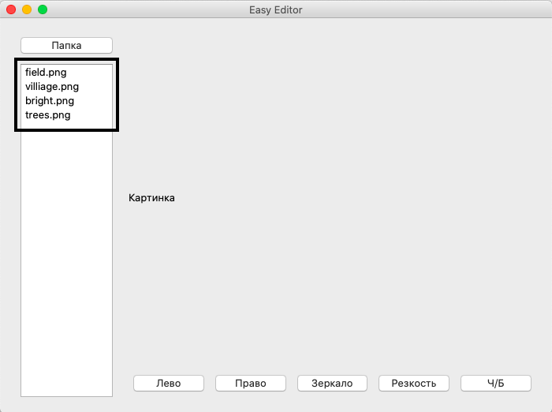
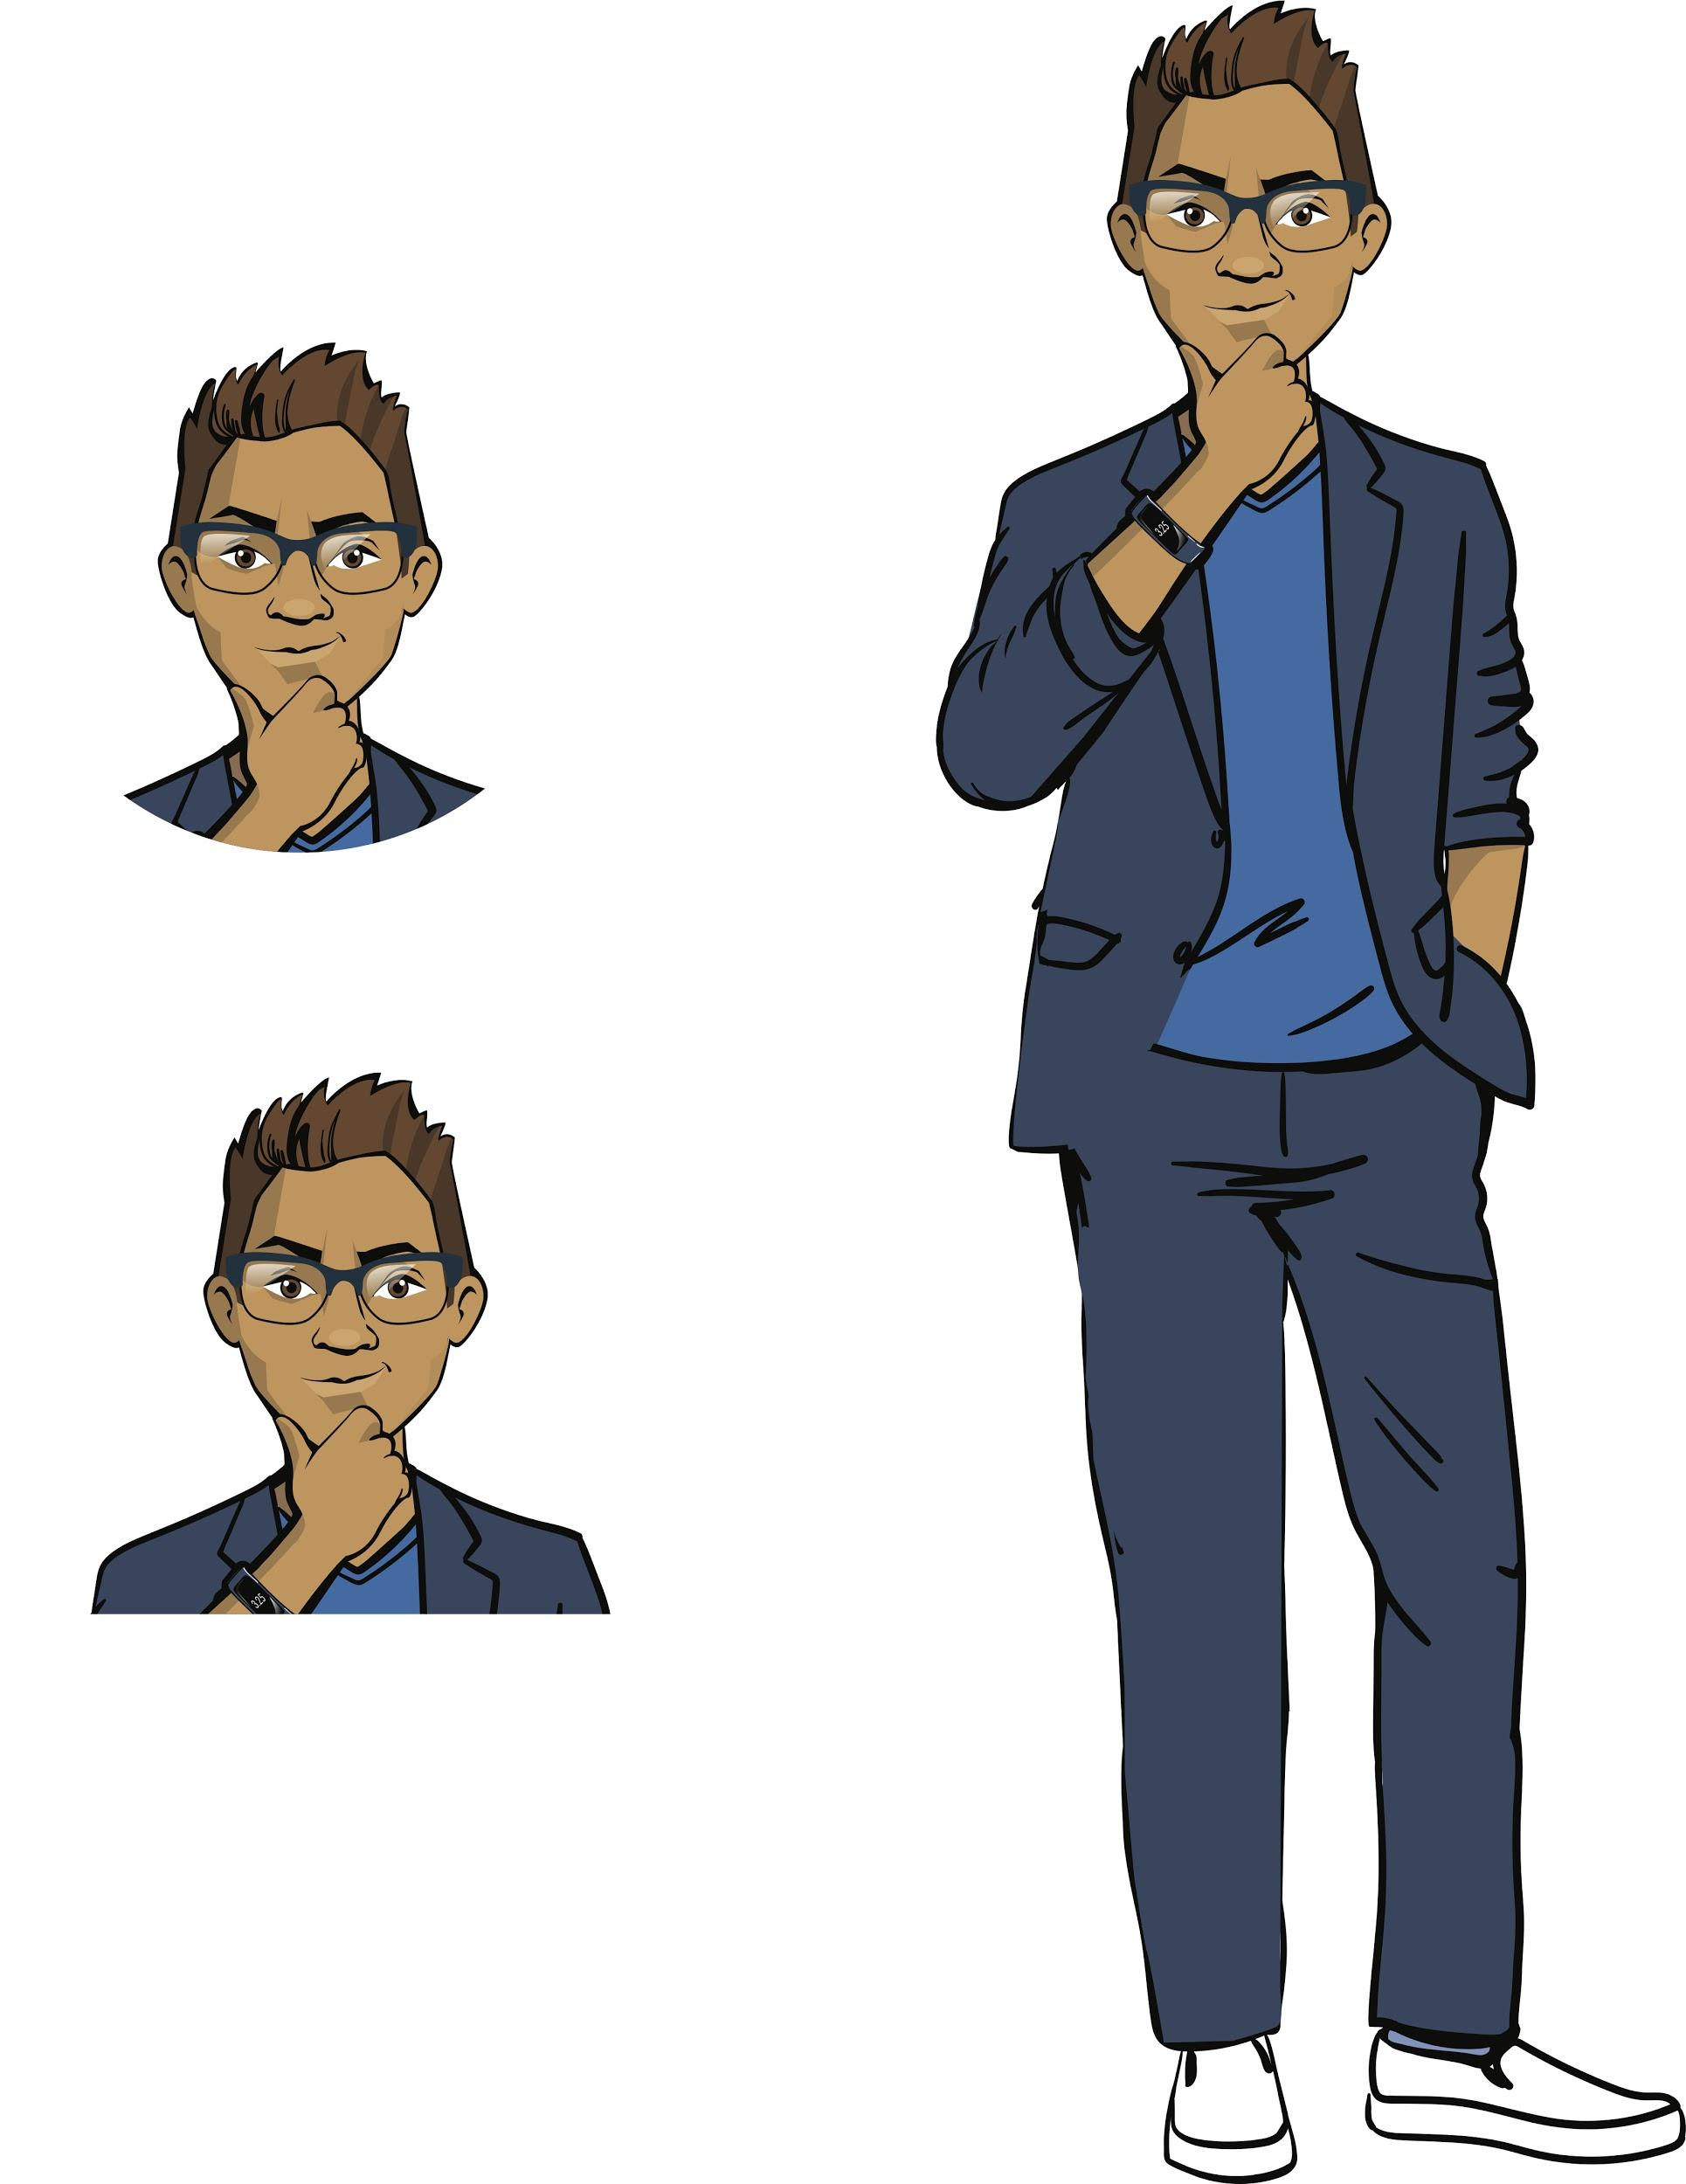
How to display the names of images from a computer folder in the app interface?
Folder
Image
Brainstorming

Slide 35
How to display the names of images from a computer folder in the app interface?
User
Computer
User clicks the “Folder” button
The user selects a folder with files
What actions should the computer take?
Brainstorming
User sees a list of filenames

Slide 36
How to display the names of images from a computer folder in the app interface?
User
Computer
User clicks the “Folder” button
Open folder selection window
The user selects a folder with files
Load all files from the folder into the program
Brainstorming
Select graphic files
Display graphic files in the list widget
User sees a list of filenames

Slide 37
Required functionality
Developer Cole suggested a list of the required functions. Some commands need to be learned before starting work.
1
PyQt window widget: QFileDialog
Open folder selection window
2
Module os: function listdir()
Load names of all files from the folder (into the program)
Brainstorming
3
Your own filter() function that selects files
Select graphic files
Display graphic files in the list widget

Slide 38
1. Selecting a folder for work
Let’s use a new widget from the PyQt5 library – QFileDialog.
It is used to call the folder selection window (File Explorer or Finder)
PyQt5:
Command | Purpose
from PyQt5.QtWidgets import QFileDialog | Connecting a widget
workdir = QFileDialog.getExistingDirectory() | Getting the path to the selected folder from the QFileDialog window
Brainstorming

Slide 39
1. Selecting a folder for work
Let’s use a new widget from the PyQt5 library – QFileDialog.
It is used to call the folder selection window (File Explorer or Finder)
PyQt5:
Command | Purpose
from PyQt5.QtWidgets import QFileDialog | Connecting a widget
workdir = QFileDialog.getExistingDirectory() | Getting the path to the selected folder from the QFileDialog window
Brainstorming
A folder path is a sequence of folder (directory) names and additional characters specifying the path to the folder.
Example: С:\User\Sasha\School\IT – '“IT” folder path

Slide 40
1. Selecting a folder for work
Let’s use a new widget from the PyQt5 library – QFileDialog.
It is used to call the folder selection window (File Explorer or Finder)
PyQt5:
Command | Purpose
from PyQt5.QtWidgets import QFileDialog | Connecting a widget
workdir = QFileDialog.getExistingDirectory() | Getting the path to the selected folder from the QFileDialog window
Brainstorming
We don’t need to set such paths manually. Python will do it for us.
Example: С:\User\Sasha\School\IT – '“IT” folder path

Slide 41
2. Get names of all files from the folder and load them into the program
Let’s use the os module from the Python standard library.
Out of many os functions, we'll use commands to access files and folders along the path.
Brainstorming

Slide 42
Module os
is in the Python standard library and contains functions for working with the operating system.
os:
Command | Purpose
import os | Connecting the os module
filenames = os.listdir(workdir) | Getting files from the folder (argument – path)
Brainstorming
The folder path was obtained at the previous step

Slide 43
Module os
is in the Python standard library and contains functions for working with the operating system.
os:
Command | Purpose
import os | Connecting the os module
filenames = os.listdir(workdir) | Getting files from the folder (argument – path)
Brainstorming
‘robotics_article.doc’
‘turtles game.py’
‘vacation2020.jpg’
‘crazy_cat.gif’
Names of different types of files were loaded.
We need to keep the graphic files only.

Slide 44
3. Selecting graphic files
Let’s select files with graphic extensions only.
It is convenient to put all valid extensions in the extensions list.
List filenames of all filenames in the workdir folder
Function selecting files with extensions from extensions in the filenames
List result
of graphic filenames in the workdir folder
Brainstorming
Listextensions of all graphic file extensions

Slide 45
3. Selecting graphic files
Let’s check which filenames have graphic file extensions (.jpg, .png, etc.)
def filter(filenames, extensions):
Create an empty list result for filenames.
For every filename from the filenames list:
And every extension from the extensions list:
If a name has this extension,
then add it to the results list.
Return the result list.
Brainstorming

Slide 46
3. Selecting graphic files
Let’s check which filenames have graphic file extensions (.jpg, .png, etc.)
def filter(filenames, extensions):
Create an empty list result for filenames.
For every filename from the filenames list:
And every extension from the extensions list:
if filename.endswith(extension):
result.append(filename)
Return the result list.
Brainstorming
Methodendswith(<string>).
Returns True ,if the filename ends with ext, and False, if not.

Slide 47
4. Displaying the name list in the widget
We have already implemented a similar task for the Smart Notes project (for a list of note titles)
def showFilenamesList():
Select the work folder (workdir).
Set the list of valid extensions.
Load the folder filenames and keep only with extensions extentions.
Clear the list widget (in case there are filenames of another folder there).
Add the selected filenames to the widget one by one.
Brainstorming

Slide 48
Let’s include code fragments into the program:
import os
from PyQt5.QtWidgets import QFileDialog
def chooseWorkdir():
def filter(files, extensions):
def showFilenamesList():
btn_dir.clicked.connect(showFilenamesList)
Connecting the rest of PyQt objects and creating an interface
Function for selecting a work folder
Function for selecting filenames by extensions
Function handling the “Folder” button click.
Responsible for choosing a folder, selecting files, and displaying them in the widget.
Uses chooseWorkdir() and filter()

Slide 49
Let’s include code fragments into the program:
import os
from PyQt5.QtWidgets import QFileDialog
def chooseWorkdir():
def filter(files, extensions):
def showFilenamesList():
btn_dir.clicked.connect(showFilenamesList)
Comment:
To work, we need not only the list of files (available in the widget) but also the work folder.
Now, the folder name is removed after showFilenamesList() finishes the operation
To save the folder, let’s define it as a
global variable.
workdir = ''
def chooseWorkdir():
global workdir
workdir = QFileDialog...
Connecting the rest of PyQt objects and creating an interface
Function for selecting a work folder
Function for selecting filenames by extensions
Function handling the “Folder” button click.
Responsible for choosing a folder, selecting files, and displaying them in the widget.
Uses chooseWorkdir() and filter()

Slide 50
import os
from PyQt5.QtWidgets import QFileDialog
workdir = '' # introducing a global variable
def chooseWorkdir():
global workdir # calling the global variable
workdir = QFileDialog.getExistingDirectory()
def filter(files, extensions):
def showFilenamesList():
btn_dir.clicked.connect(showFilenamesList)
The command word global tells the interpreter that the result should be stored in a global variable.
Connecting the rest of PyQt objects and creating an interface
Function for selecting filenames by extensions
Function handling the “Folder” button click.
Responsible for choosing a folder, selecting files, and displaying them in the widget.
Uses chooseWorkdir() and filter()

Slide 51
Task:
Write functions to select the working directory and display names of graphic files from it in the widget.
Folder
Brainstorming
Image

Slide 52
Module 4. Lesson 2. The Easy Editor project. P. 1
VS Code:
The Easy Editor app

Slide 53
Complete task 2 in VS Code
The Easy Editor app
Visual Studio Code
Working on the platform

Slide 54

Module 4. Lesson 2. The Easy Editor app P. 1
Wrapping up the workday

Slide 55

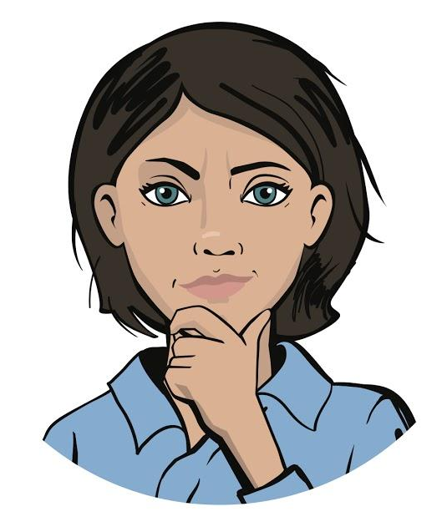
To complete, pass a technical interview:
Which module contains functions for working with the computer’s operating system?
What variable is called global? Why is the workdir variable defined globally?
Wrapping up the workday
Cole,
Senior Developer
Emily,
Project Manager

Slide 56
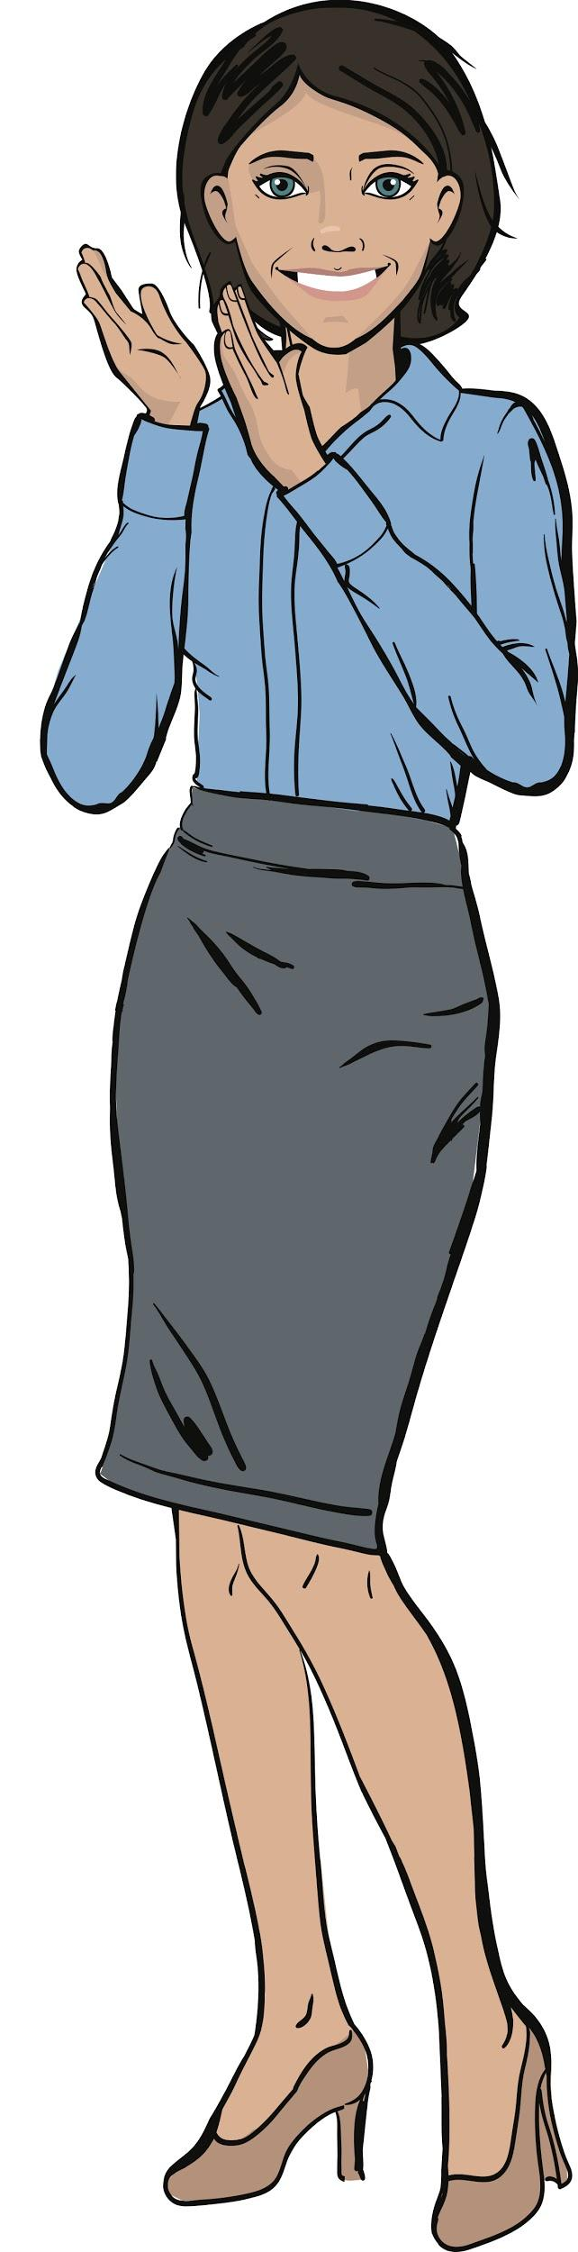
Great job!
Dear colleagues!
You’ve done a great job today.
Next workday we will continue working on the Easy Editor app and use it to process the first photos!
Wrapping up
How tothe workday

